Slide 1


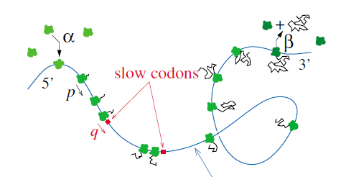
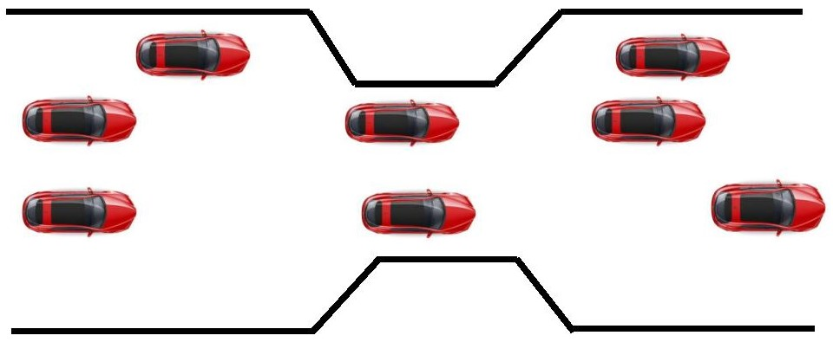
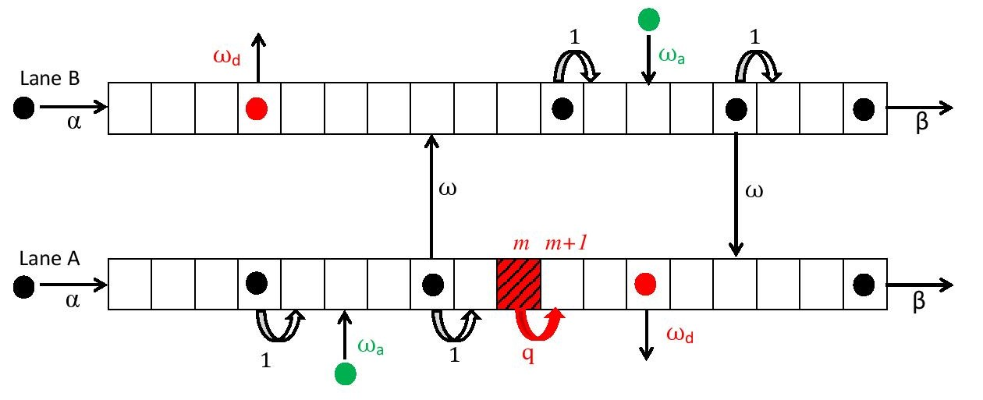
Steady-state properties of a two-channel inhomogeneous exclusion process
Isha Dhiman*, Arvind K. Gupta
Indian Institute of Technology Ropar, Punjab, India.
*Email-id: ishad@iitrpr.ac.in
Introduction
Results
Numerical scheme
This study is motivated mainly by these two real world examples of transport systems-
slowing down of protein
synthesis due to lower
concentrations of t-RNA
emergence of
bottlenecks on
highways
Fig 1: Top - Translation by slow codon in protein synthesis (ref. [1])
Bottom – cars moving through a bottleneck on a highway
Fig 3: Height of local spike with respect to q and Ω.
Triangles denote results from Monte Carlo simulations
Aims
To develop a general theoretical approach to study
inhomogeneous multi-channel transport systems
To derive steady-state phase diagrams and analyze
the observed non-equilibrium phenomena
To examine the effect of various parameters on
steady-state dynamics
Fig 4: Left: Formation of a bottleneck-induced shock from upward spike.
Right: critical bottleneck rate vs. lane-changing rate
Fig 5: Phase Diagrams- Left: q=0.5 and Right: q=0.1.
Red dots: bottleneck-affected region. I: (S_{b}-S,S_{b}/S), II: (S_{b}-
LD,S_{b}/S), III: (HD-LD,S_{b}/S), IV: (HD-S,S_{b}/S), V:(HD-S,S).
Dynamical rules
Firstly a lane and then a site i are selected at random.
Two-channel model
If i = 1, particle entrance occurs with a rate α, if site is vacant; otherwise particle moves forward, if site is occupied.
If i = L, particle exit out of the selected lane with a rate β, if site is occupied
If 1< i < L (bulk), then particle, if
present, tries to detach with a rate
ω_{d}. If not, then particle tries to hop
forward with a rate p_{i,j} ;otherwise
lane-changing occurs with a rate ω.
If site is vacant, particle
attachment occurs with a rate ω_{a}.
Fig 2: Two-channel totally asymmetric simple exclusion process with Langmuir kinetics with a bottleneck in lane A
Fig 6: Top left: position of bottleneck-induced shock vs. lane-
changing rate. Top right: Turning effect by bottleneck-
induced shock. Bottom: Finite-size effect
Particles obey hard-core exclusion principle
Bottleneck is fixed in bulk in lane A
to avoid interactions with boundaries.
Symmetric lane-changing rule
Conclusions
Mean-field hybrid system
A new hybrid approach based on mean-field
approximation theory is introduced, with which we have
derived steady-state phase diagrams for the model.
The bottleneck affected region expands with an
increase in the strength of bottleneck.
An increase in lane-changing rate helps in reducing the
congestion in the lane with bottleneck and hence,
affects positively the stationary dynamics.
The bottleneck-induced shock is present not only in
inhomogenous lane A, but also in homogeneous lane B.
Turning effect, in which bottleneck-induced shock firstly
moves rightwards and then changes its direction has
been found to be a finite-size effect, which disappears
with an increase in system size.
Lane A
Lane B
Continuum part for
Discrete part at m^{th} and (m+1)^{th} site in lane A
Continuum part for
Parameters
q (transition rate through bottleneck),
L (length of each lattice)
ε=1/L (lattice constant)
t’=t/L (rescaled time)
Ω = ω L (rescaled lane-changing rate)
Ω_{d} = ω_{d} L (rescaled detachment rate)
Ω_{a} = ω_{a} L (rescaled attachment rate)
K = ω_{a}/ ω_{d} (binding constant)
References
T. Chou, G. Lakatos, Phys. Rev. Lett. 93 (19) 198101, 2004.
R. Wang, M. Liu, R. Jiang, Physica A 387 (2) 457, 2008.
I. Dhiman and A. K. Gupta, J. Comput. Phys 309, 227, 2016.
Boundary Conditions:
Acknowledgements
CSIR, New Delhi, India for Senior Research Fellowship
Organizers of STATPHYS 26 for financial support
Indian Institute of Technology Ropar for financial support

